Slide 1
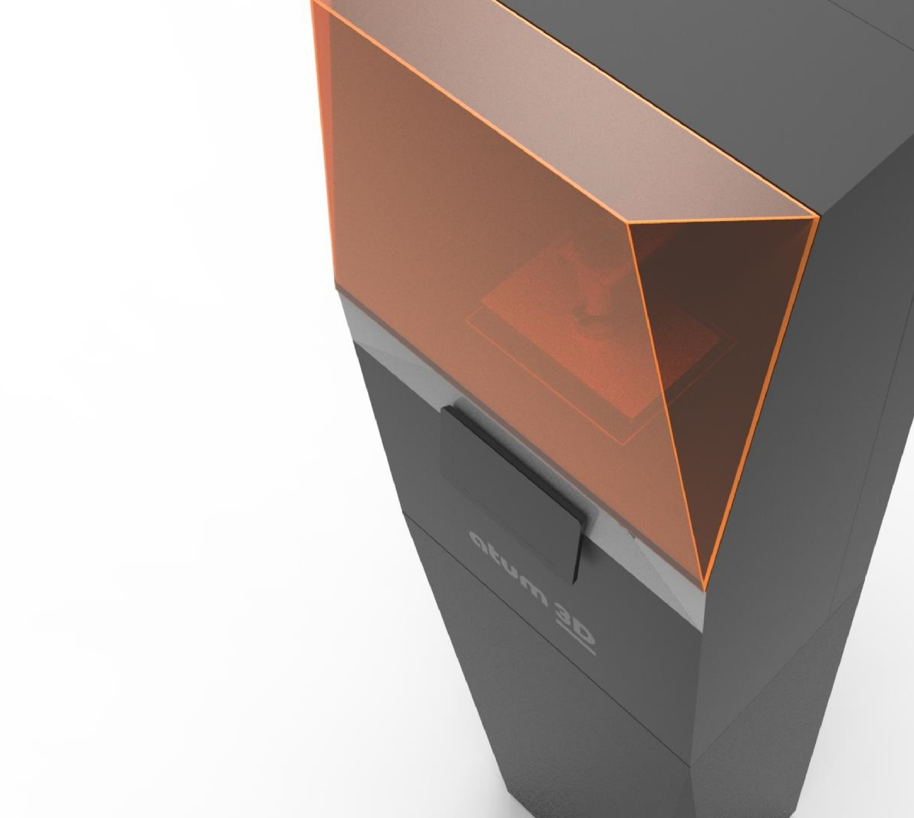
Company Presentation June, 2018 Tristram Budel

Slide 2
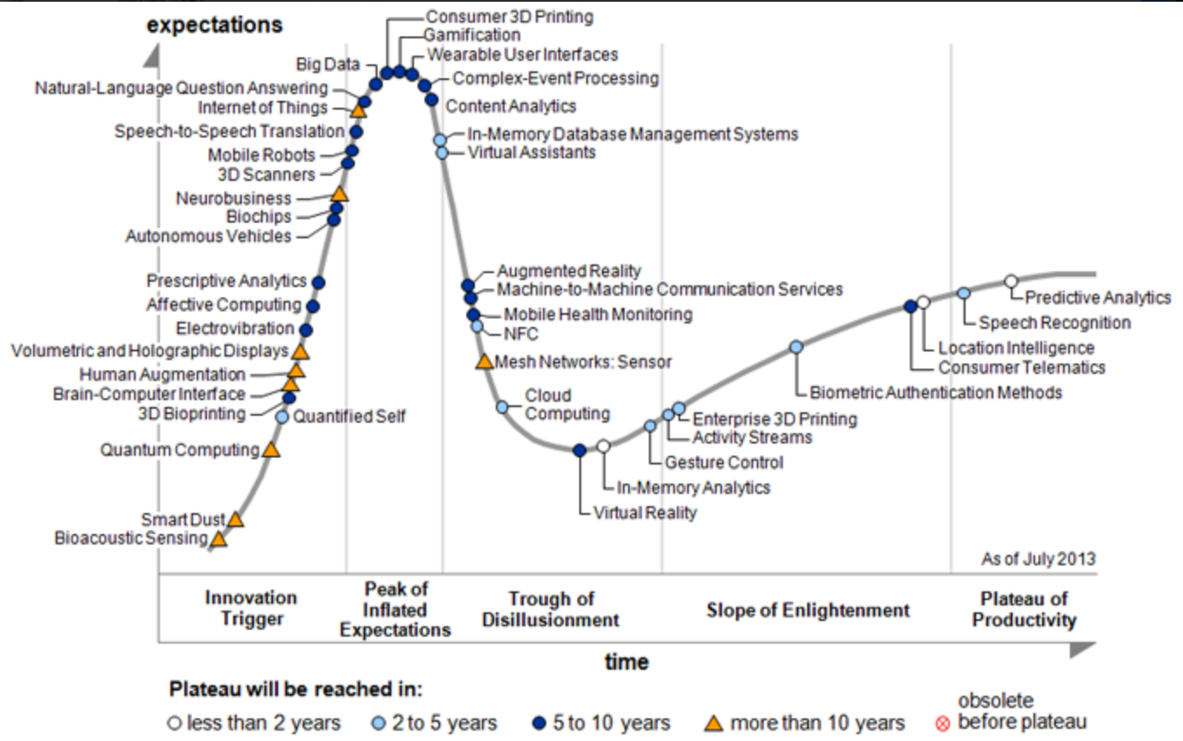
Atum3D
10 employees
+ 300 sold total
Open platform

Slide 3
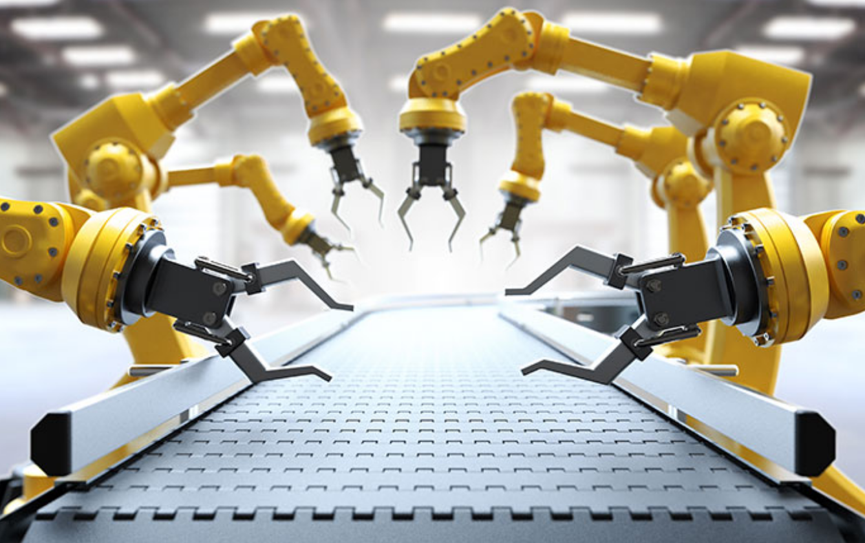
Key 3D printing topics
Additive manufacturing automation
Material properties

Slide 4
Accelerate together
Building application orientated packages

Slide 5
Thanks for your attention!
Marconistraat 66A
2809 PE Gouda
The Netherlands
T +31 (0)85-4882660
E info@atum3D.com
www.manufactur3D.com
www.atum3d.com

